Slide 1


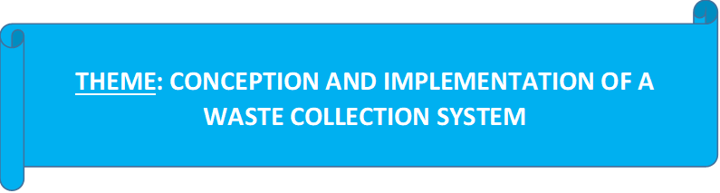
REPUBLIC OF CAMEROON
Peace - Work - Fatherland
REPUBLIQUE DU CAMEROUN
Paix – Travail - Patrie
AFRICAN INSTITUTE OF COMPUTER SCIENCES - CAMEROON OFFICE
PAUL BIYA TECHNOLOGICAL CENTER OF EXCELLENCE
P.O. Box: 13719 Yaoundé
Tel: +237.242.729.957 Fax: 22729958
E-mail: contact@iaicameroun.com
Web site: www.iaicameroun.com
REALIZE
Tel: (237) 620256960/654486985
Email : realize.contactus@gmail.com
Web site: www.realize.cm
Internship carried out from the 03rd of July till the 30th of September 2024. In view of obtaining a Software Engineering Diploma in Computer Sciences Option: Software Engineering
Written by:
NSAN SAMUEL PENIEL
Level II Software Engineering student
Supervision:
Professional Supervisor:
Mr. MENGOT NSO
Software Engineer
Academic Supervisor:
Mr. ASSANE DERICK
Lecturer at AICS-Cameroon
Academic Year 2024 - 2025

Slide 2
E-Waste COLLECTION SYSTEM
Here is where your presentation begins.

Slide 3
Table of contents
01
Introduction
02
Context and Problematic
03
Methodology
04
Demonstration
05
Conclusion

Slide 4
Let’s Start!
This can be the part of the presentation where you introduce yourself, write your email…

Slide 5
01
INTRODUCTION
You can enter a subtitle here if you need it

Slide 6
Do you need longer text?
Mercury is the closest planet to the Sun and the smallest one in the entire Solar System. This planet’s name has nothing to do with the liquid metal, since Mercury was named after the Roman messenger god. Despite being closer to the Sun than Venus, its temperatures aren’t as terribly hot as that planet’s. Its surface is quite similar to that of Earth’s Moon, which means there are a lot of craters and plains
Speaking of craters, many of them were named after artists or authors who made significant contributions to their respective fields. Mercury takes a little more than 58 days to complete its rotation, so try to imagine how long days must be there! Since the temperatures are so extreme, albeit not as extreme as on Venus, and the solar radiation is so high, Mercury has been deemed to be non-habitable for humans

Slide 7
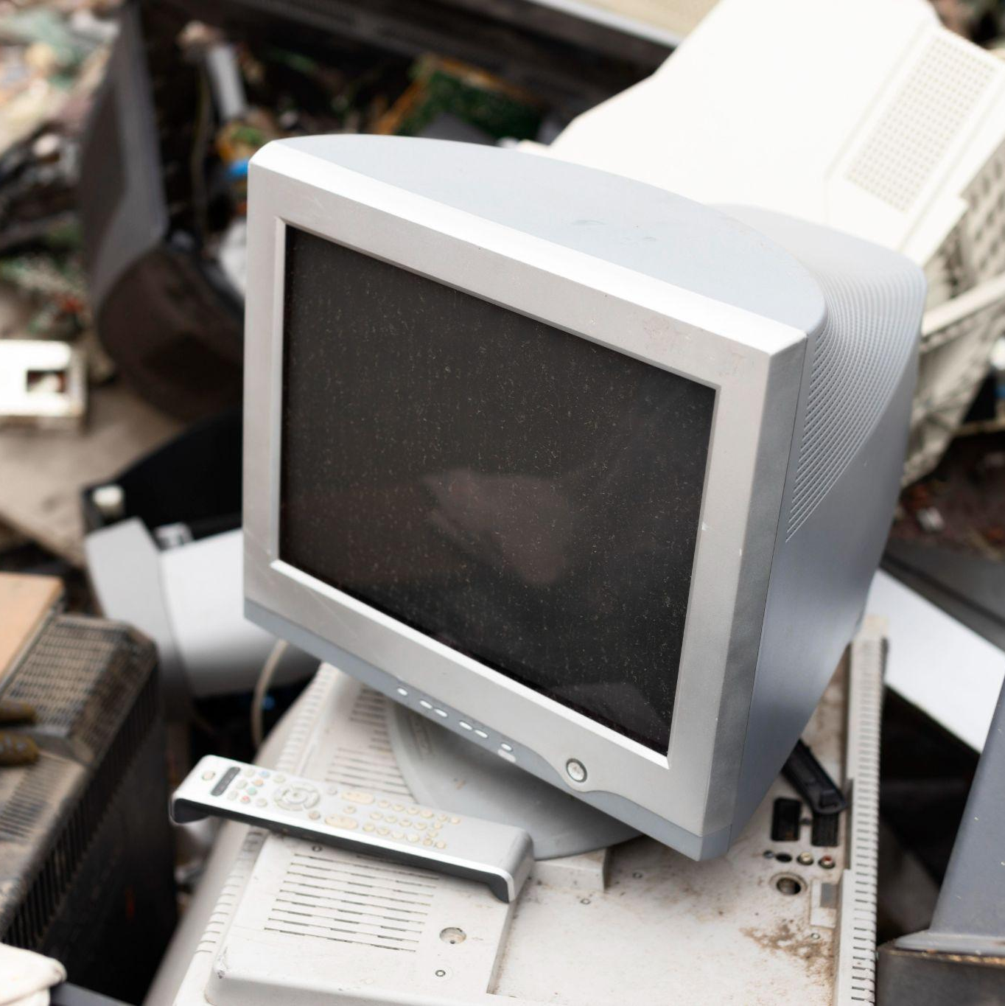
The slide title goes here!
Do you know what helps you make your point crystal clear? Lists like this one:
They’re simple
You can organize your ideas clearly
You’ll never forget to buy milk!
And the most important thing: the audience won’t miss the point of your presentation

Slide 8
You need to divide the content
Mercury
Venus
Mercury is the closest planet to the Sun and the smallest one in the System—it’s only a bit larger than the Moon
Venus has a beautiful name and is the second planet from the Sun. It’s hot and has a poisonous atmosphere

Slide 9
Here are three important ideas
Mercury
Venus
Mars
Mercury is the closest planet to the Sun and the smallest of them all
Venus has a beautiful name and is the second planet from the Sun
Despite being red, Mars is actually a cold place. It’s full of iron oxide dust

Slide 10
02
Context and Problematics
You can enter a subtitle here if you need it

Slide 11
—Someone Famous
“This is a quote, words full of wisdom that someone important said and can make the reader get inspired”

Slide 12
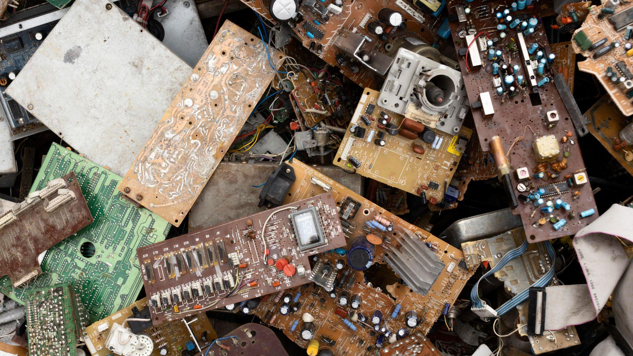
A picture is worth a thousand words

Slide 13
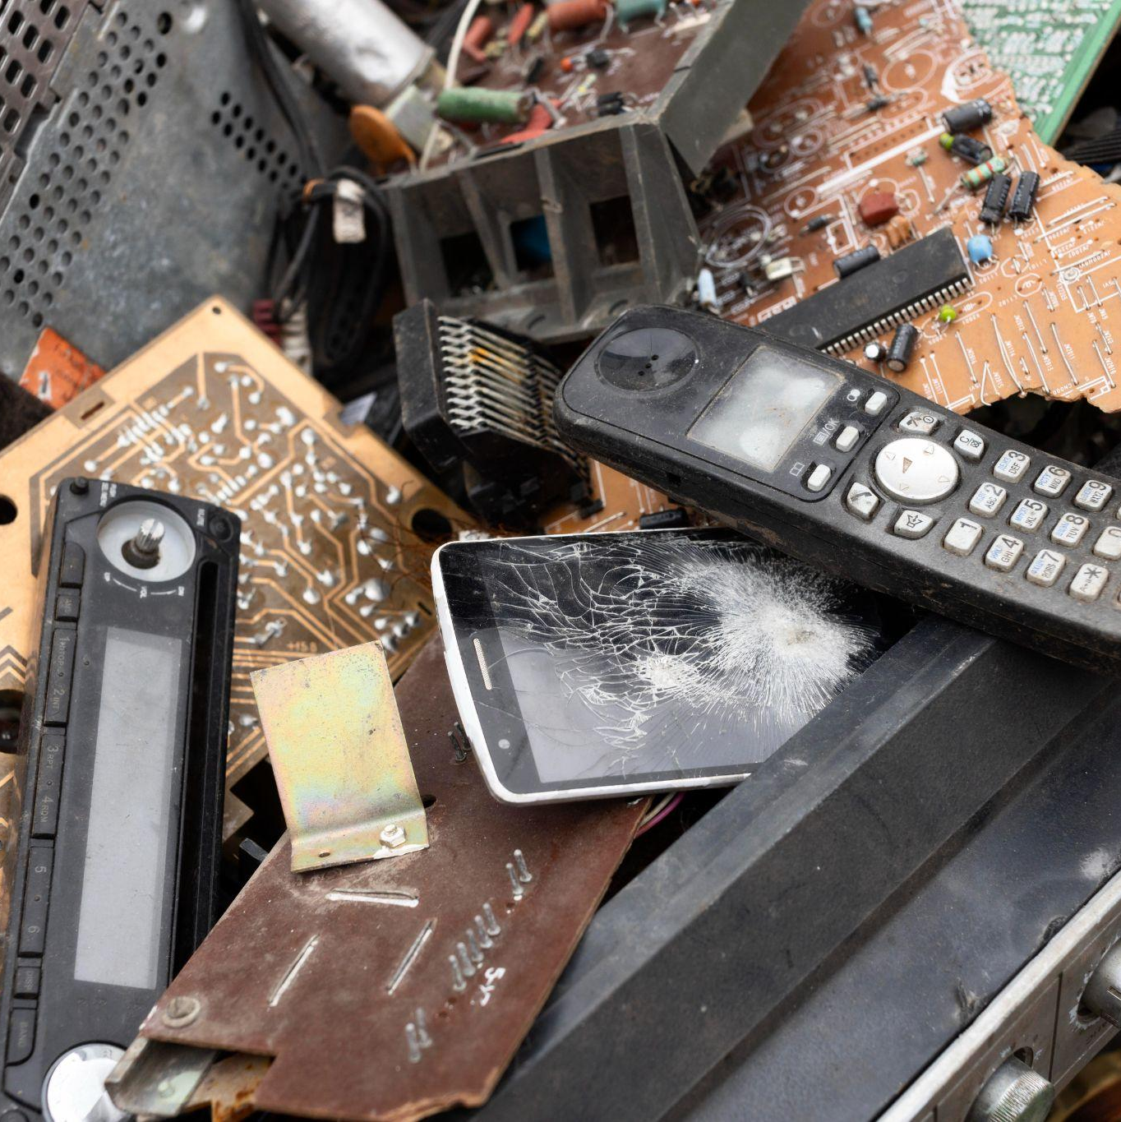
A picture always reinforces
the concept
Images reveal large amounts of data, so remember: use an image instead of a long text. Your audience will appreciate it

Slide 14
4,498,300,000
Big numbers catch your audience’s attention

Slide 15
9h 55m 23s
333,000
386,000 km
Jupiter’s rotation period
The Sun’s mass compared to Earth’s
Distance between Earth and the Moon

Slide 16
Let’s use some percentages
25%
45%
75%
Mercury
Venus
Mars
Mercury is the closest planet to the Sun and the smallest of them all
Venus has a beautiful name and is the second planet from the Sun
Despite being red, Mars is actually a cold place. It’s full of iron oxide dust

Slide 17
This is a map
Venus
Venus is the second planet from the Sun
Mercury
Mercury is the closest planet to the Sun
Mars
Despite being red, Mars is a very cold place

Slide 18
A timeline always works well
01
02
03
04
Venus
Mercury
Mars
Jupiter
Venus is the second planet from the Sun
Mercury is the closest planet to the Sun
Despite being red, Mars is a very cold place
Jupiter is the biggest planet of them all

Slide 19
This is a diagram
E-Waste
Earth
Mars
Jupiter
Saturn
Earth is the third planet from the Sun
Despite being red, Mars is very cold
Jupiter was named after a Roman god
Saturn is a gas giant and has rings

Slide 20
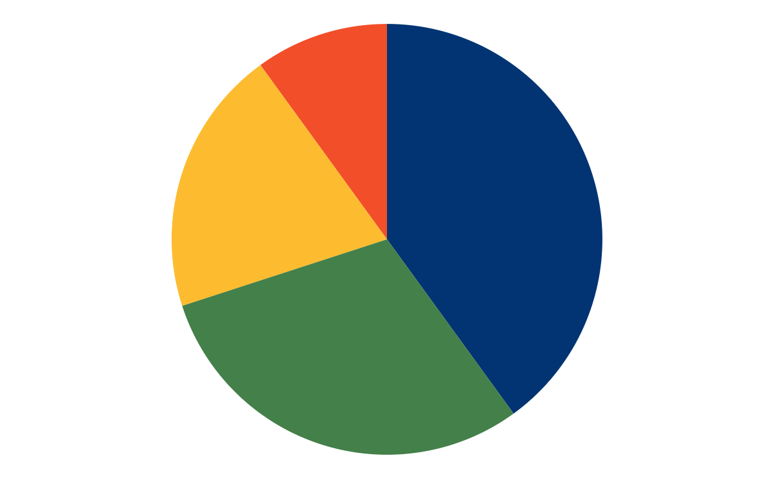
This is a graph
Earth
10%
40%
Jupiter
Mars
20%
30%
Saturn
Earth is the third planet from the Sun
Jupiter was named after a Roman god
Despite being red, Mars is very cold
Saturn is a gas giant and has rings
Follow the link in the graph to modify its data and then paste the new one here. For more info, click here

Slide 21
03
Methodology
You can enter a subtitle here if you need it

Slide 22

04
Demonstration
You can enter a subtitle here if you need it

Slide 23
Demonstration
05
You can enter a subtitle here if you need it

Slide 24
This is a checklist
01 | Mars is actually a very cold place
02 | Venus has extremely high temperatures
03 | Neptune is the farthest planet from the Sun
04 | Mercury is the closest planet to the Sun
05 | Saturn is a gas giant with several rings

Slide 25
This is an infographics
Earth
Jupiter
Mars
Saturn
Earth is the third planet from the Sun
Jupiter was named after a Roman god
Despite being red, Mars is very cold
Saturn is a gas giant and has rings

Slide 26
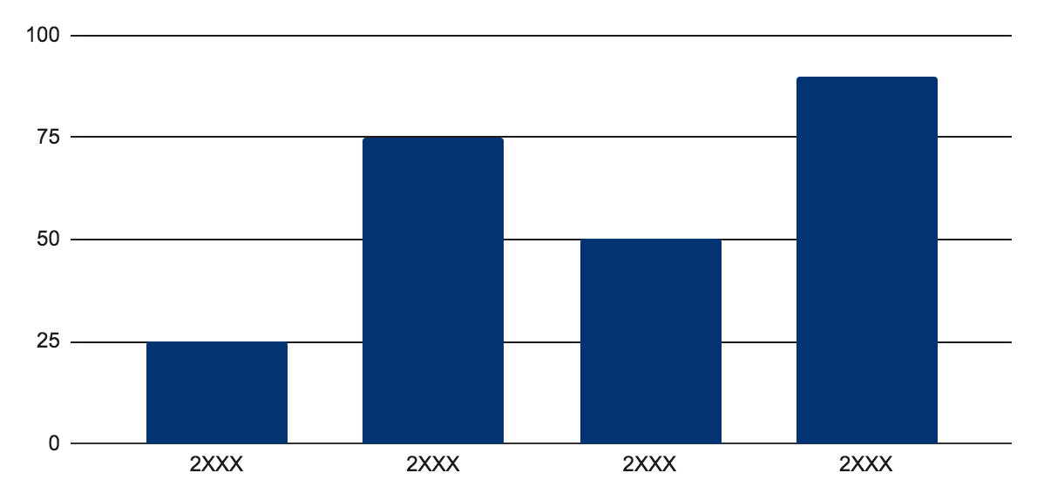
You can use this graph
Mercury
Mercury is the closest planet to the Sun and the smallest one in the entire Solar System. This planet’s name has nothing to do with the liquid metal, since Mercury was named after the Roman messenger god
Follow the link in the graph to modify its data and then paste the new one here. For more info, click here

Slide 27
Points to consider
Here you can write about the points to consider about the topic
Here you can write about the points to consider about the topic
Here you can write about the points to consider about the topic
Here you can write about the points to consider about the topic
Here you can write about the points to consider about the topic
Here you can write about the points to consider about the topic
Here you can write about the points to consider about the topic
Here you can write about the points to consider about the topic
Here you can write about the points to consider about the topic
Here you can write about the points to consider about the topic

Slide 28
Conclusion
05
Mercury is the closest planet to the Sun and the smallest one in the entire Solar System. This planet’s name has nothing to do with the liquid metal, since Mercury was named after the Roman messenger god. Despite being closer to the Sun than Venus, its temperatures aren’t as terribly hot as that planet’s

Slide 29
Thanks!

Slide 30
Alternative resources
Here’s an assortment of alternative resources whose style fits the one of this template:
Vectors
Hand drawn people using technological devices pack

